Slide 1
Switch Statements
and
Other Conditionals

Slide 2
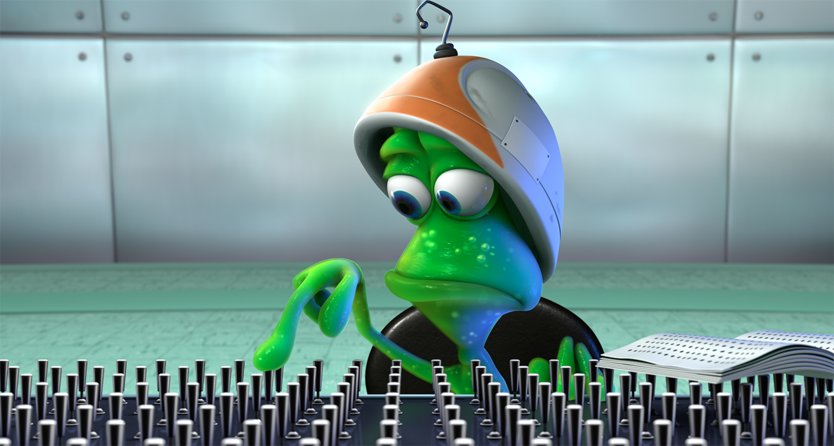
What We’ll Be Doing Today
Switch Statement Syntax
Switch Statement Applications
Conditional Operators
Java Structure

Slide 3
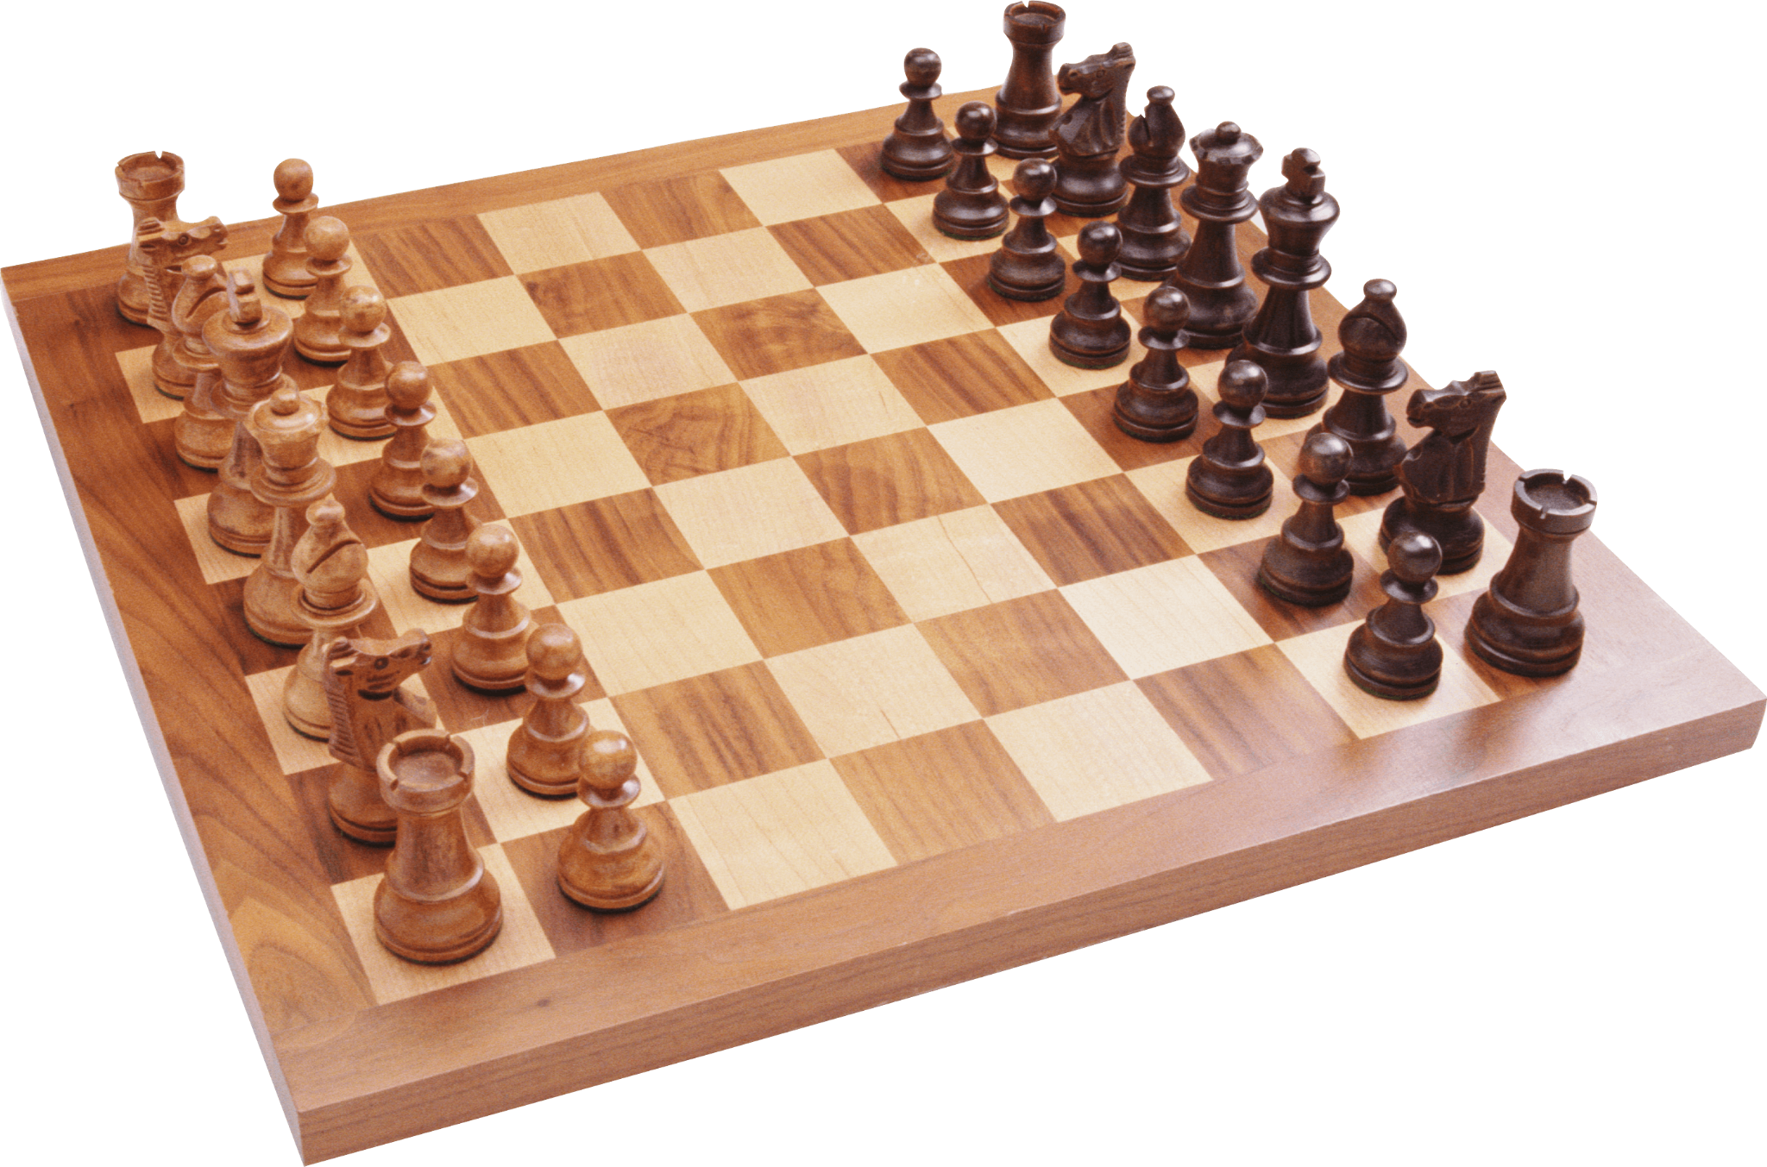
Chess Example
x-axis
y-axis
Unicode Pieces: ♖♘♗♔♕♗♘♖
♙♙♙♙♙♙♙♙
♟︎♟︎♟︎♟︎♟♟︎♟︎♟︎
♜♞♝♛♚♝♞♜
You may need to run:
chcp 65001
In your terminal if these characters don’t show up.
T
I
M
E

Slide 4
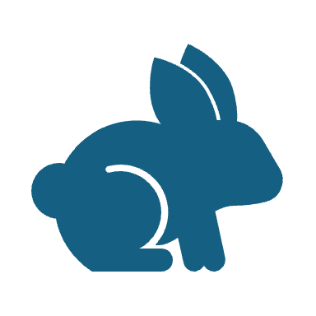
Let's Hop in Live Share

Slide 5
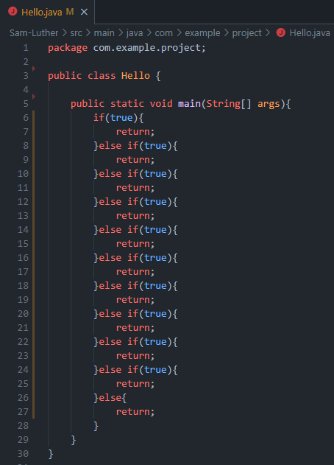
Switch Statements
Are a way of avoiding huge if-else blocks which can be hard to read and maintain.
As with many things in Java switch statements are not required for the compiler or for some specific use case.
They are simply used to help the human interacting with your program.

Slide 6
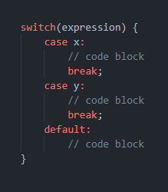
Basic Syntax

Slide 7
Basic Syntax
Expression - refers to the thing you will be switching on. This could be a variable or even an operation on a variable. Eg: i%2.
Case - is more or less going to take a potential or desired output from the expression in your switch. Can be treated as an if-true type statement.
Default - this code is only executed if no other cases fit the output of the expression.

Slide 8
Basic Syntax
Expression - refers to the thing you will be switching on. This could be a variable or even an operation on a variable. Eg: i%2.
Case - is more or less going to take a potential or desired output from the expression in your switch. Can be treated as an if-true type statement.
Default - this code is only executed if no other cases fit the output of the expression.

Slide 9
Basic Syntax
Expression - refers to the thing you will be switching on. This could be a variable or even an operation on a variable. Eg: i%2.
Case - is more or less going to take a potential or desired output from the expression in your switch. Can be treated as an if-true type statement.
Default - this code is only executed if no other cases fit the output of the expression.

Slide 10
Stack Trace this operation
The switch expression is evaluated once.

Slide 11
Stack Trace this operation
The switch expression is evaluated once.
The value of the expression is compared with the values of each case.

Slide 12
Stack Trace this operation
The switch expression is evaluated once.
The value of the expression is compared with the values of each case.
If there is a match, the associated block of code is executed.

Slide 13
Stack Trace this operation
The switch expression is evaluated once.
The value of the expression is compared with the values of each case.
If there is a match, the associated block of code is executed.
The break and default keywords are optional, and will be described later.

Slide 14
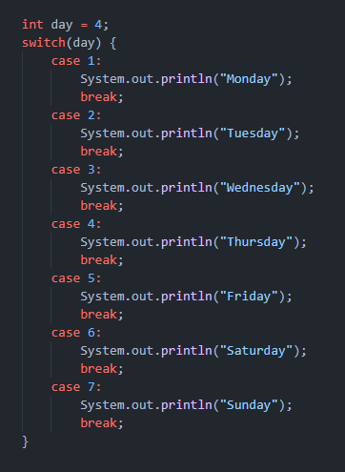

Slide 15
The break Keyword
When Java reaches a break keyword, it breaks out of the switch block.

Slide 16
The break Keyword
When Java reaches a break keyword, it breaks out of the switch block.
This will stop the execution of more code and case testing inside the block.

Slide 17
The break Keyword
When a match is found, and the job is done, it's time for a break. There is no need for more testing.

Slide 18
The break Keyword
When a match is found, and the job is done, it's time for a break. There is no need for more testing.
A break can save a lot of execution time because it "ignores" the execution of all the rest of the code in the switch block.

Slide 19
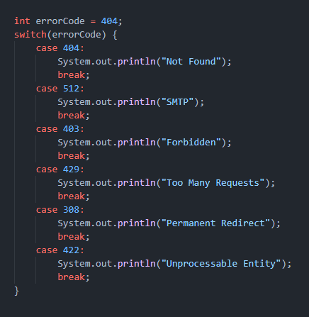
Switch Applications and Optimizations
As a result of the way breaks ignore all lower cases it doesn’t make sense to add this statement to your last case or your default case for example.

Slide 20
Switch Applications and Optimizations
As a result of the way breaks ignore all lower cases it doesn’t make sense to add this statement to your last case or your default case for example.
Switch statements are useful in any instance of a simple expression with potential for many outputs, each of which must be separately handled.

Slide 21
Switch Applications and Optimizations
The main case that I like switch statements for is user input and handling the different inputs I’d like to handle.
You can optimize inputs further by making your input variable either uppercase or lowercase or by stacking cases.

Slide 22
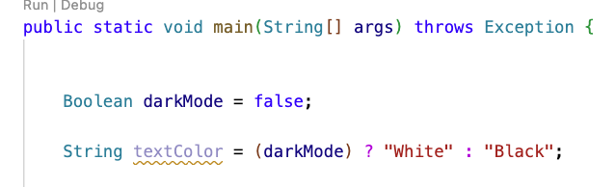
Conditional Operators
Significantly less common in java than any other conditionals.
Used pretty often in languages other than Java.
A shorthand conditional in an expression format.
Can be quite stylish but often frowned upon.

Slide 23
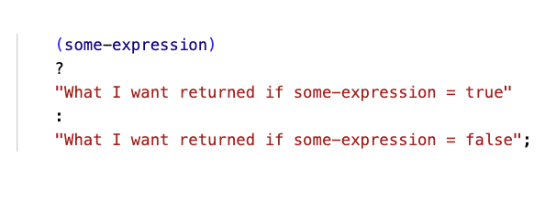
Conditional Operators
Conditional Operators are technically ternary operators (acting on three operands).
The i++ expression would be a unary operator (acting upon one operand), i + 1 would be a binary operator (acting upon two operands).

Slide 24
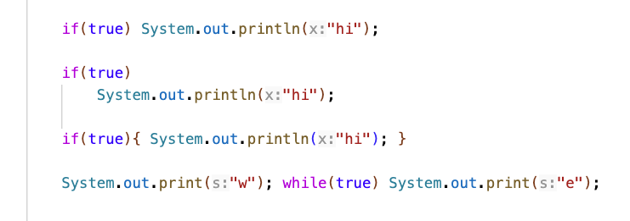
A Java Structural Shortcut
If a structure using curly braces in java would only enclose one line of code, you can omit the curly braces.

Slide 25
Closing
Office Hours In SS-411:
Tu & Th 2pm – 3pm
Mon & Wed 10am–11am
Have a great weekend and I’ll see you on Wednesday!

